Slide 1






GROUP MEMBERS
SHARON NJUGUNA
WAIRATI SERENA
JOSHUA WAIRUA

Slide 2







PROJECT NAME:
LOANLENS:
AUTOMATING LOAN ELIGIBILITY FOR SMARTER HOUSING FINANCE

Slide 3

PROBLEM
The company aims to automate the Loan Eligibility Process in real time by leveraging customer details provided in home loan application forms.

Slide 4

PROBLEM STATEMENT
Manual loan approval processes are slow, biased, and inefficient
High volume of applications overwhelms staff
Inconsistent decisions due to human subjectivity
Delayed approvals frustrate applicants
Risk of giving loans to non-eligible customers

Slide 5
SOLUTION
An intelligent, data-driven model to automate loan eligibility checks.
✅ Uses historical customer data to predict loan approval likelihood
✅ Segments applicants based on risk and eligibility
✅ Reduces manual workload and decision time
✅ Enhances transparency and customer trust

Slide 6

Work Flow
Data Collection
Application details: income, dependents, education, credit history, etc.
Data Cleaning & Preprocessing
Handle missing values, encode categorical variables
Model Training
Classification model (e.g., Logistic Regression / Random Forest)
Prediction & Segmentation
Outputs: “Approved”, “Not Approved”, or “Uncertain”
Deployment & Integration
Connect with loan portal or internal systems

Slide 7




Our Inputs
01
02
03
04
05
LoanAmount
Dependents
Education
Self Employed
CoapplicantIncome
06
07
08
09
10
Married
Loan Amount Term
Credit History
Gender
Applicant Income
11
12
Property Area
Applicant Income

Slide 8
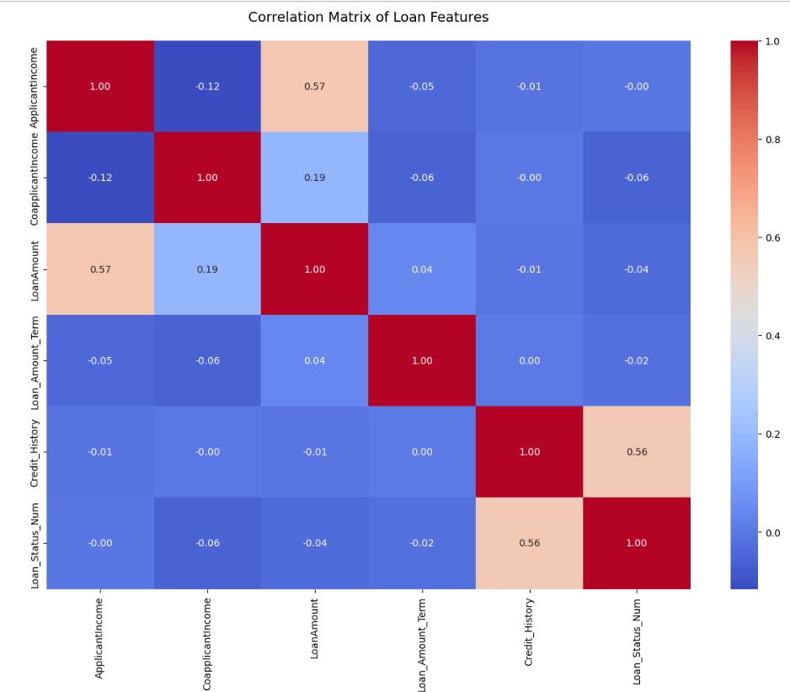

Slide 9
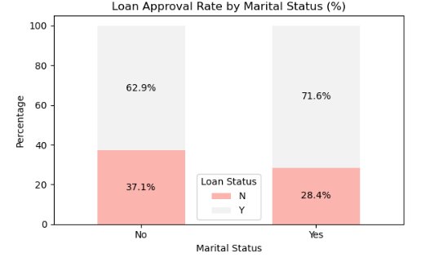
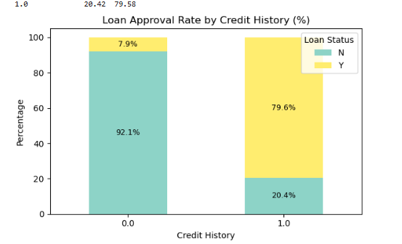

Applicants with good credit history (1.0) are much more likely to have their loan approved.
Approval rate is very high (80%)
Applicants with bad credit history (0.0) are rarely approved.
Approval rate is extremely low (10%)
Married applicants had a significantly higher loan approval rate (71%) compared to unmarried applicants (62%), possibly due to dual income or perceived stability.

Slide 10
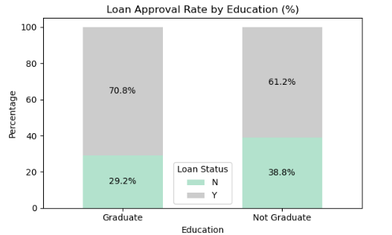
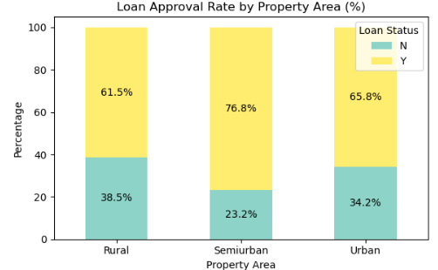
Education level does have an impact on loan approval
This suggests that graduates have a noticeably higher chance of getting loan approval compared to those who are not graduates
Semiurban applicants have the highest loan approval rate (~77%).
Urban applicants have moderate approval (~66%)
Rural applicants have the lowest approval rate (~61.5%).

Slide 11
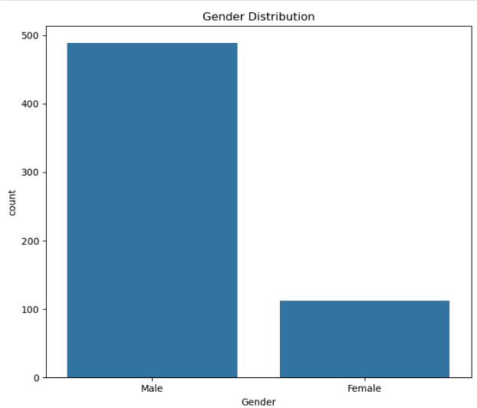
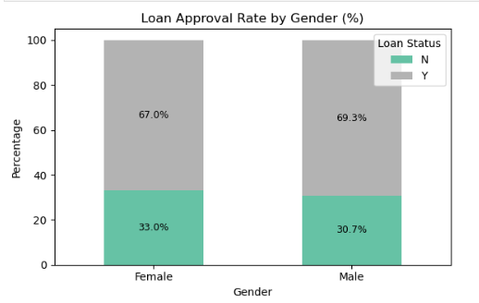
gender does not appear to influence loan approval decisions.
Both male and female applicants had nearly equal approval rates, indicating that the loan approval process is not biased towards either gender.
While more male applicants applied for loans than female applicants , the approval rates between the two genders were nearly identical.

Slide 12
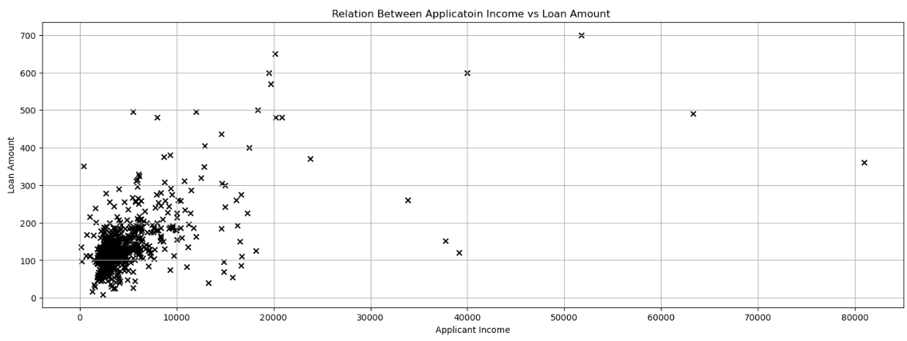

Applicants with higher incomes tend to receive higher loan amounts.
This trend suggests that the loan approval system likely considers the applicant's income as a key factor when determining the loan amount.
A higher income may reflect a stronger repayment capacity, which increases both the eligibility and the amount approved.

Slide 13
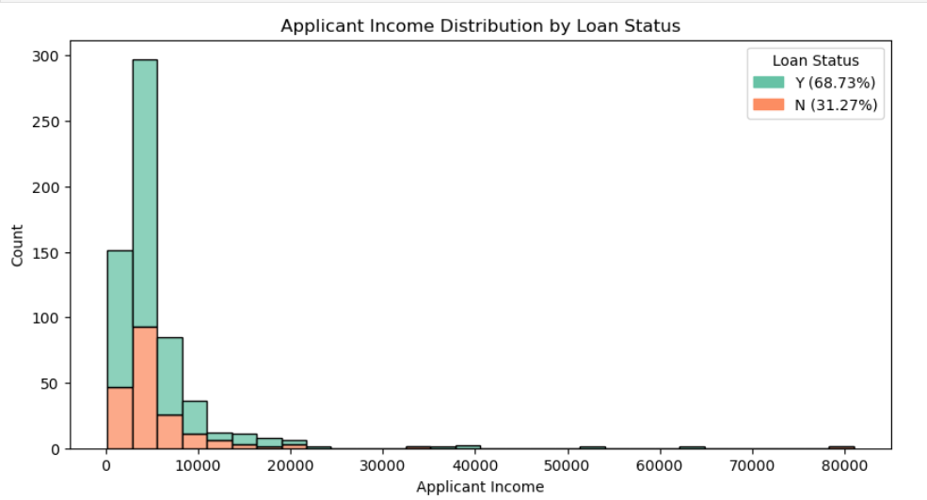
Higher income generally increased approval chances, but not always.

Slide 14
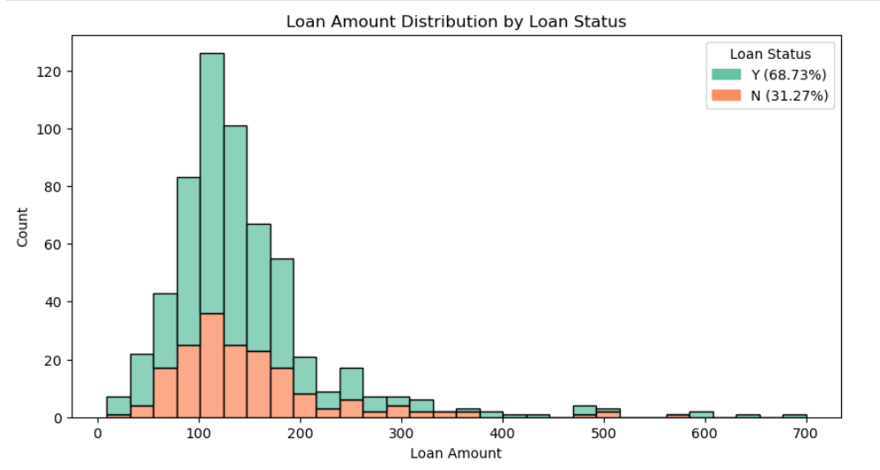

Slide 15






FEATURES WHICH ARE MOST IMPORTANT IN PREDICTING LOAN ELIGIBILITY
LOAN AMOUNT
CREDIT
HISTORY
APPLICANTINCOME
This was by far the most significant feature.
Applicants with a good credit history ( represented as 1) were much more likely to be approved for a loan.
The model heavily relied on this feature when making predictions.
Income played a key role in determining whether an applicant could afford the loan.
However, we noticed that higher income doesn't always guarantee approval, especially if other factors like credit history are poor.
The amount requested relative to the income was important.
Large loan amounts with lower incomes tended to get rejected unless supported by strong credit history.

Slide 16
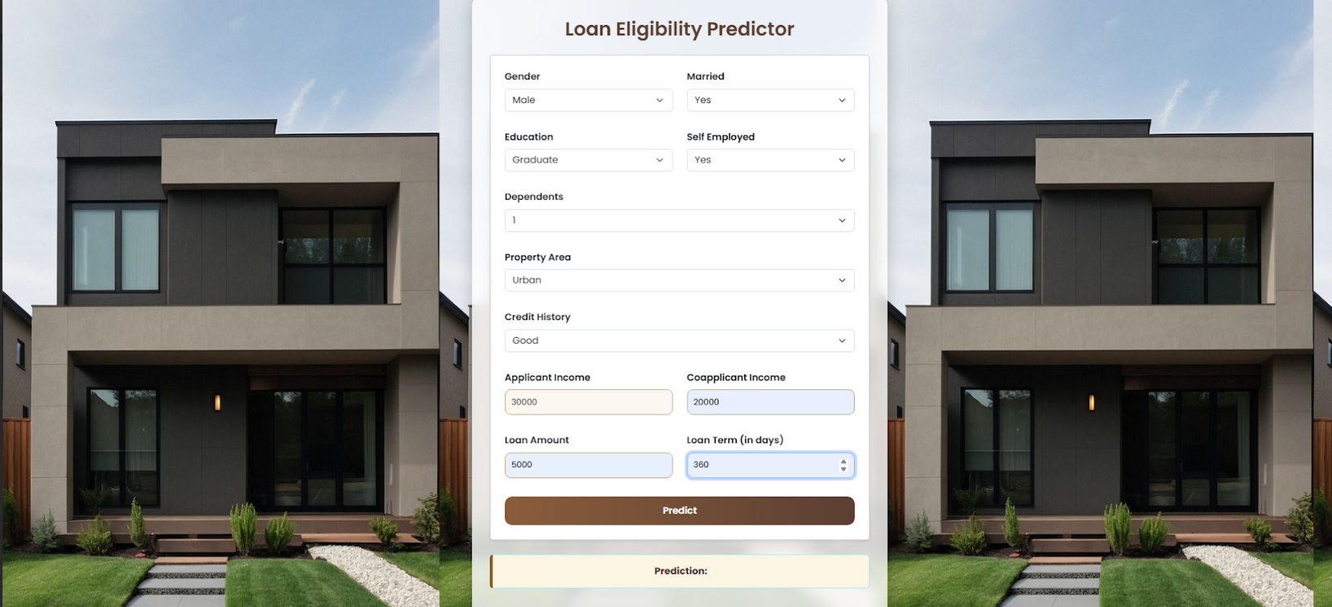

Slide 17
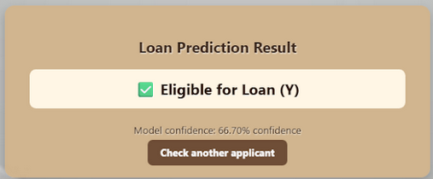

Slide 18
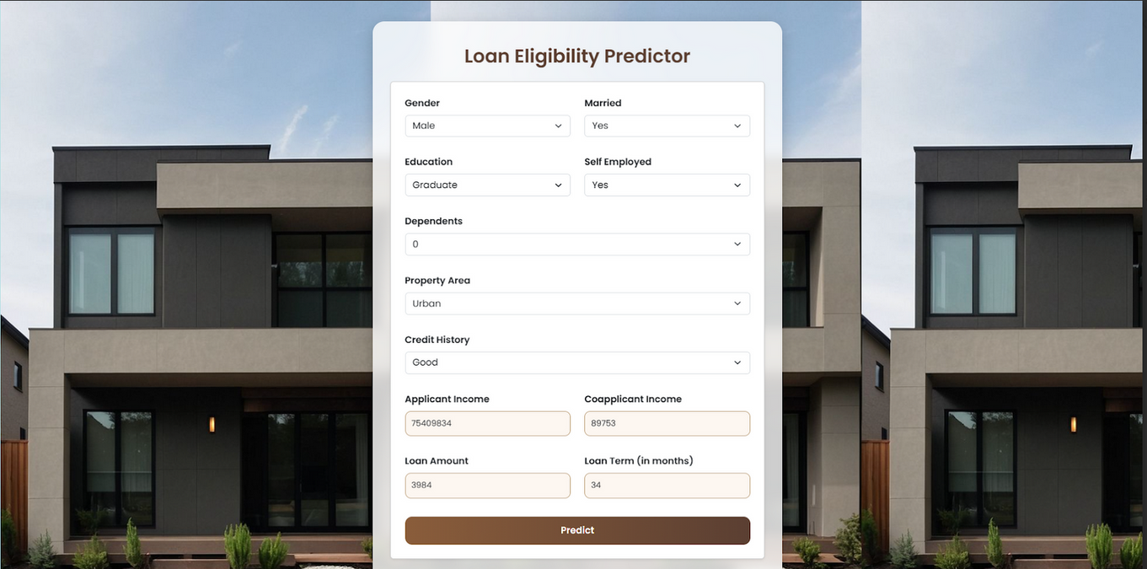

Slide 19
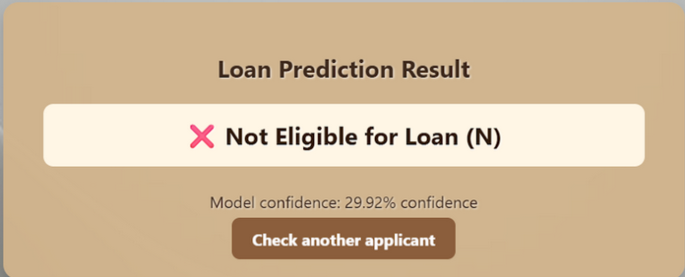

Slide 20
WHAT CUSTOMER PROFILE IS MOST LIKELY TO GET APPROVED?
Good Credit History
This is the strongest indicator.
Customers with a credit history marked as 1 (i.e., a record of repaying loans) have very high chances of approval.
🔹 Moderate to High Applicant Income
While very high income isn’t always necessary, stable and sufficient income is important.
Especially when it’s proportional to the requested loan amount.
🔹 Low to Moderate Loan Amount
Customers requesting realistic loan amounts (not too high compared to income) tend to get approved.

Slide 21
Education: Graduate
Graduates have slightly better chances, possibly due to perceived job stability and better income potential.
🔹 Employment: Salaried or Self-Employed with Consistent Income
Stable income sources boost eligibility, regardless of job type.
🔹 Married Status with Coapplicant Income
Being married often comes with a coapplicant (e.g., spouse), which increases total household income and improves approval chances.
🔹 Property Location: Semi-Urban or Urban
Applicants purchasing property in semi-urban or urban areas see slightly higher approval rates, likely due to higher property value and lower risk.

Slide 22
Actionable recommendations the housing finance company can implement to improve customer targeting and automate loan approvals effectively
1. Implement a Pre-Screening System Using the ML Model
Action: Integrate the trained machine learning model into the loan application system to automatically flag high-probability approvals.
Impact: Reduces manual screening time and focuses staff attention on borderline or complex cases.
2. Segment Customers Based on Approval Likelihood
Action: Use clustering or scoring to group customers into:
High eligibility (fast-track)
Medium eligibility (manual review)
Low eligibility (rejected or alternative offers)
Impact: Streamlines processing by prioritizing high-likelihood applicants and reducing unnecessary checks.
3. Promote Loan Products to High-Potential Segments
Action: Use insights from the model to target marketing towards:
Salaried professionals
Customers with good credit history
Applicants from semi-urban/urban areas
Impact: Increases conversion rates and reduces cost per acquisition.

Slide 23
4. Offer Personalized Loan Amount Suggestions
Action: Based on applicant income and credit profile, recommend a safe loan amount range before submission.
Impact: Reduces rejection rates and improves customer experience.
5. Automate Low-Risk Approvals with Threshold Rules
Action: If an applicant meets high-confidence conditions (e.g., good credit, stable income, acceptable DTI), automatically approve subject to documentation.
Impact: Cuts down turnaround time significantly.
6. Flag Risky Applications for Deeper Analysis
Action: Automatically highlight profiles with:
Missing credit history
Unusually high loan requests
Inconsistent income data
Impact: Prevents high-risk approvals and reduces potential defaults.
7. Provide Credit Education for Low-Eligibility Customers
Action: For customers denied due to credit history, offer:
Credit-building programs
Tips on improving eligibility
Impact: Improves financial inclusion and builds long-term customer relationships.

Slide 24
8. Continuously Retrain the Model with New Data
Action: Collect feedback on actual loan outcomes (approved/rejected + repayment status), and retrain the model every quarter.
Impact: Maintains model accuracy over time and adapts to changes in applicant behavior.
9. Use Explainable AI Tools in Approvals
Action: Integrate SHAP or LIME to give customers and loan officers transparent reasons for approval or rejection.
Impact: Builds trust in the system and helps customers understand how to improve their eligibility.

Slide 25
CUSTOMER SEGMENTS MOST LIKELY TO BE APPROVED
1. Applicants with a Good Credit History
Credit_History = 1 is the strongest approval indicator.
These applicants have demonstrated reliability in repaying previous loans.
2. Salaried Individuals with Stable Income
Regular monthly income from employment (vs. irregular or self-employed with unknown income).
Preferably with ApplicantIncome above the median.
3. Married Applicants with a Coapplicant
Combining incomes improves affordability.
Coapplicant income reduces the debt-to-income ratio, increasing approval chances.

Slide 26
4. Graduates
Education = Graduate: More likely to have better earning potential and job security.
Slightly higher approval rates observed in EDA and model outputs.
5. Applicants Requesting Reasonable Loan Amounts
Approval more likely when LoanAmount is proportional to income.
Very high loan amounts (especially with low income) are red flags.
6. Applicants from Semi-Urban or Urban Areas
Properties in Urban/Semi-Urban areas carry less risk and higher resale value.
These segments tend to have higher approval rates.
7. Applicants with Fewer Dependents
Fewer dependents suggest lower financial burden, improving perceived loan repayment capacity.

Slide 27
MARKETING & CUSTOMER TARGETING INSIGHTS
1. Target Customers with Good Credit History
Insight: Credit history is the #1 predictor of loan approval.
Action: Focus marketing campaigns on customers with an existing credit score or past loan history.
Tactics: Partner with credit bureaus to pre-qualify and pre-approve potential customers.
2. Promote Loans to Salaried Professionals
Insight: Salaried individuals show higher approval rates due to income stability.
Action: Create targeted offers for professionals in stable industries (e.g., government workers, teachers, IT staff).
Tactics: Use employment-based filters in advertising or workplace-based promotions.
3. Offer Pre-Qualified Loans to Urban & Semi-Urban Residents
Insight: Urban and semi-urban property applicants are more likely to be approved.
Action: Focus outreach on these geographic areas.
Tactics: Use property location data and local agents to drive campaigns in these regions.

Slide 28
4. Encourage Coapplicant Loans Among Married Couples
Insight: Applications with a coapplicant (especially spouse) have higher approval chances due to increased total income.
Action: Promote joint home loan packages with lower interest or flexible terms.
Tactics: Use family-based messaging in campaigns and bundle offers.
5. Educate Low-Credit or First-Time Borrowers
Insight: A large portion of rejected applications come from customers with no or poor credit history.
Action: Run financial literacy campaigns to teach credit-building habits.
Tactics: Offer credit-builder products or "starter loans" to help these customers qualify in the future.
6. Use Loan-to-Income Ratio as a Targeting Filter
Insight: Applicants requesting a reasonable loan amount relative to their income are more likely to be approved.
Action: Set internal filters to only show loan ads to people within a safe loan-to-income band.
Tactics: Use personalized loan amount suggestions in app or website interfaces.
7. Leverage Graduate Status for Predictive Marketing
Insight: Graduates tend to be more eligible and have higher success rates.
Action: Target recent graduates or alumni networks with home loan starter plans.
Tactics: Partner with universities and professional networks.

Slide 29






Q&A SESSION

Slide 30

Thank
You

